Slide 1
Women's E-Commerce Retail Performance & Return Rate Analysis
Presented by
POOJA S NAIR

Slide 2
Dataset Overview
Kaggle dataset containing 50,000 product records with zero missing values.
Women's E-Commerce Clothing Reviews & Sales
Records: 50,000 rows
Features: 15 columns
Data types: numerical and categorical variables
Main areas: products, price, discount, ratings, reviews, stock, sales and returns

Slide 3
Project Objective
Analyze women’s clothing e-commerce data using Python.
Understand product sales, pricing and discounts.
Examine ratings, customer reviews and return rates.
Analyze stock levels and product characteristics.
Identify patterns and generate business insights.

Slide 4
Data Loading & Initial Inspection
Imported Pandas, NumPy, Matplotlib and Seaborn.
Loaded the CSV dataset using pandas.read_csv().
Checked the first rows using head().
Checked dataset size using shape.
Checked data types using dtypes.
Reviewed statistical summaries using describe().

Slide 5
Additional Columns
Discount Amount = Price × Discount % / 100
Selling Price = Original Price − Discount Amount
Sales Category = Low Sales / Medium Sales / High Sales
Price Category = Budget/Mid range/Premium

Slide 6
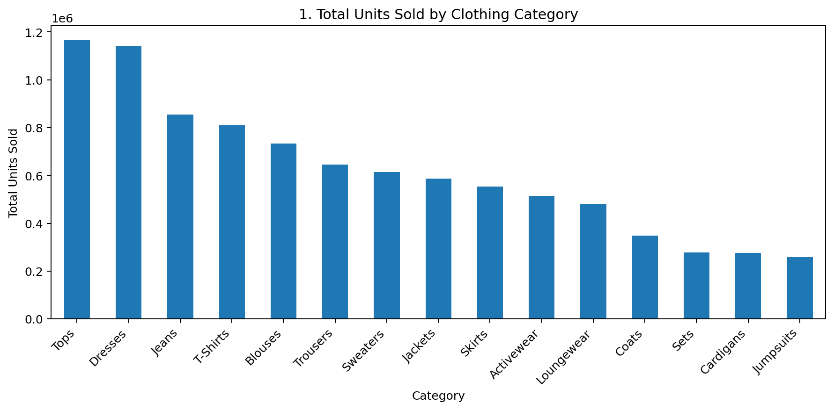
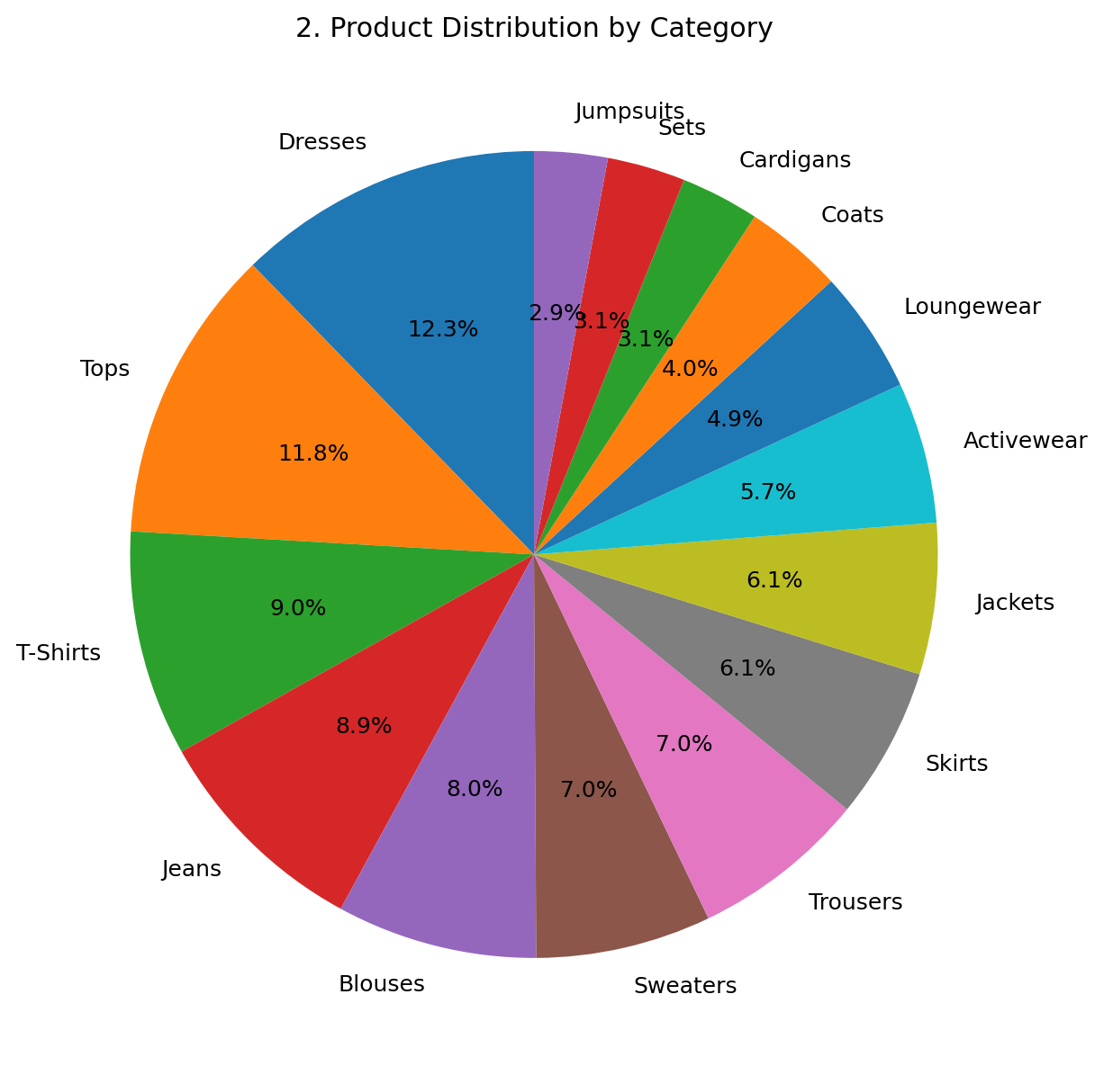
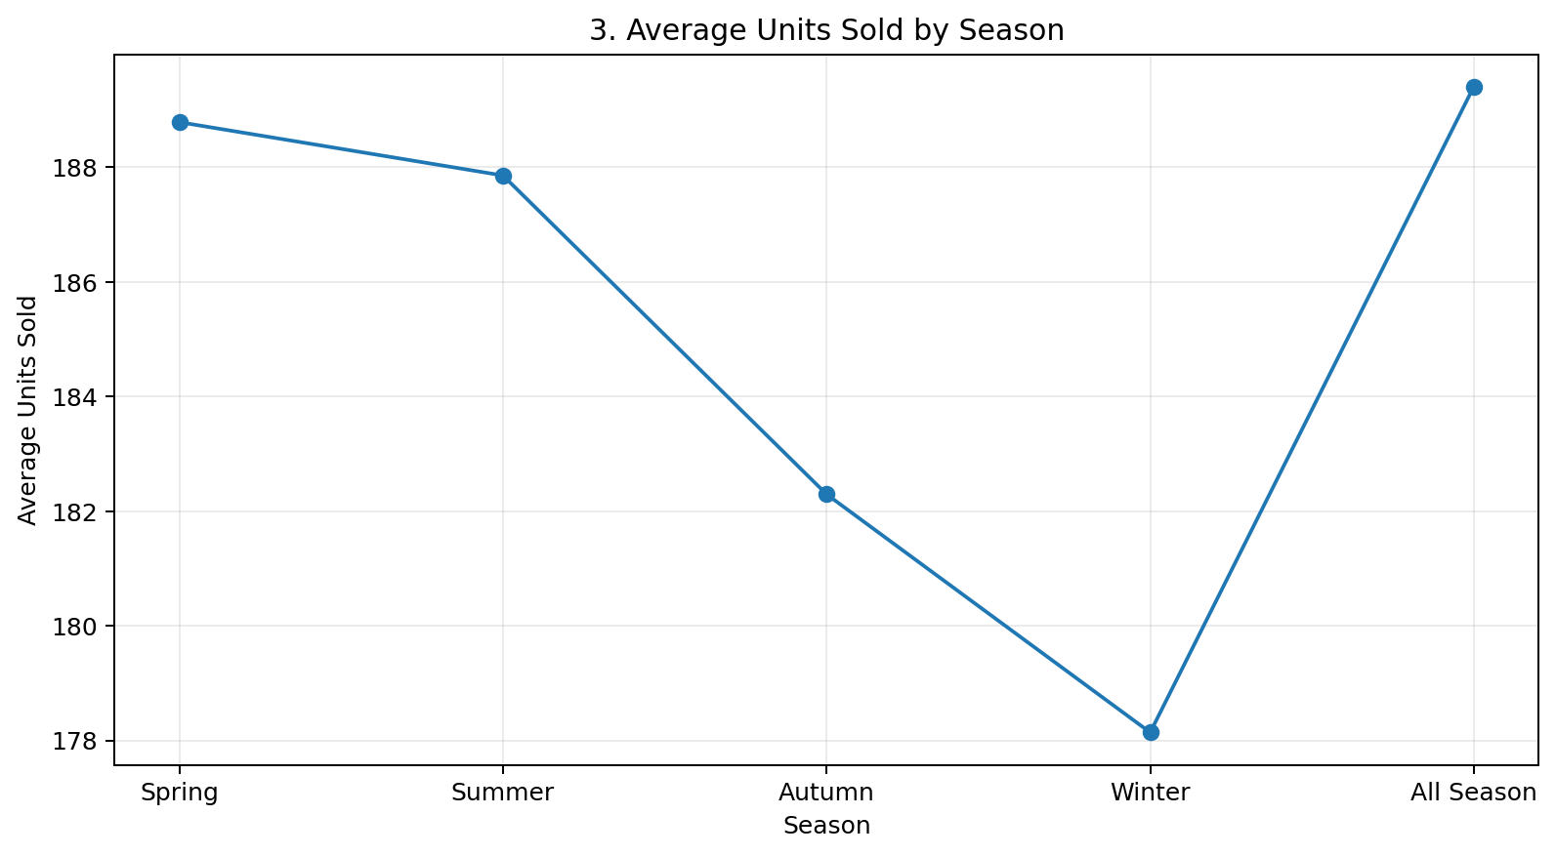
EDA Visualizations — Charts 1 to 3
Tops and Dresses have the highest total units sold among the categories.
The product mix is spread across 15 categories; Dresses and Tops are the largest groups by record count.
Spring shows the highest average sales among the listed seasons in this dataset.

Slide 7
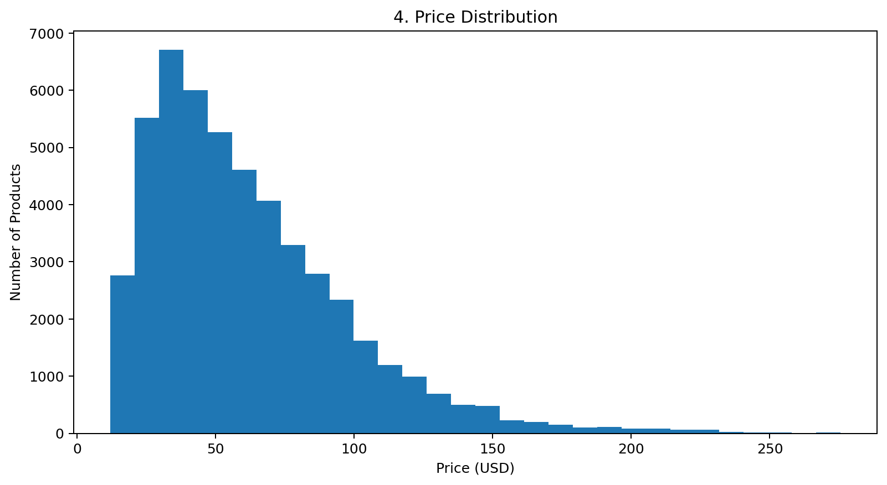
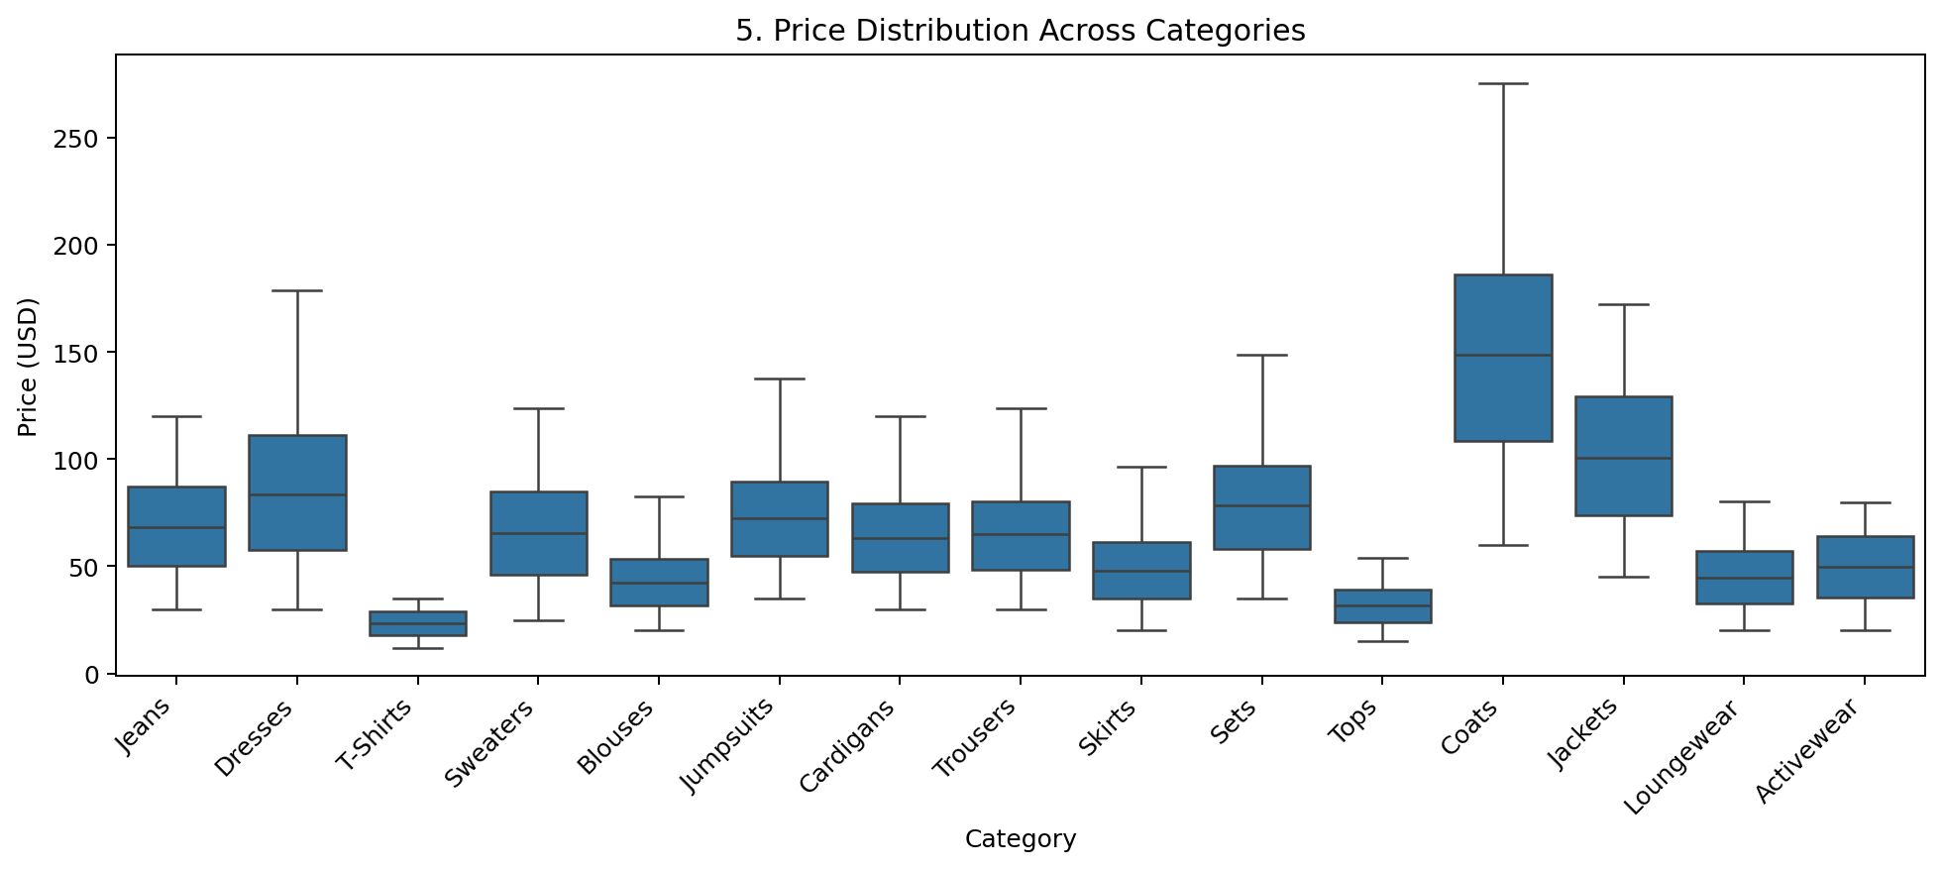
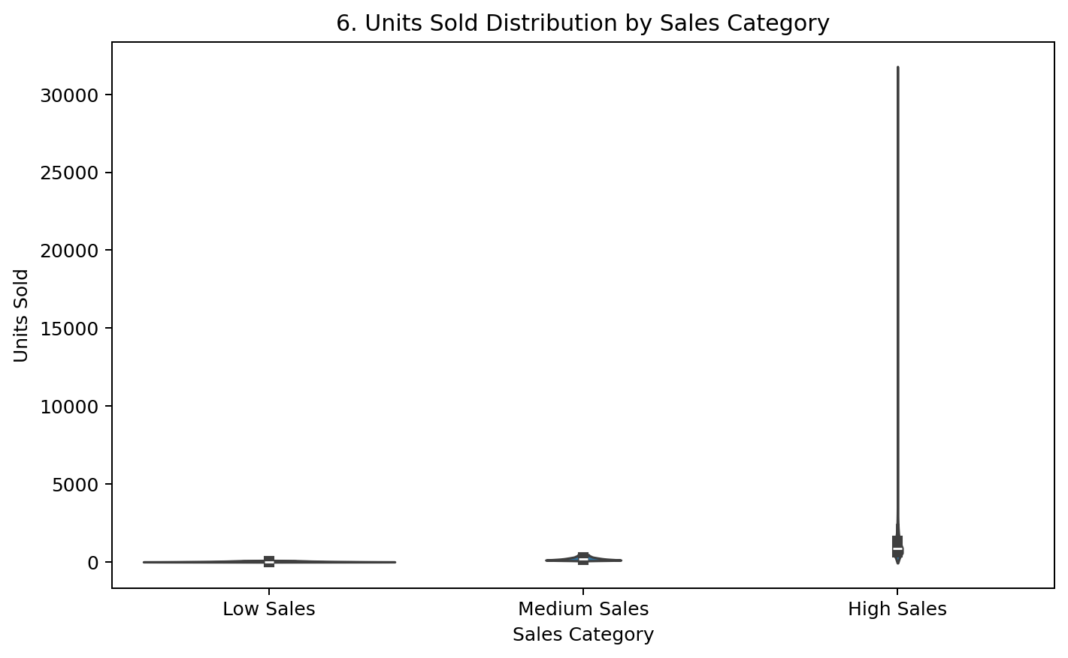
EDA Visualizations — Charts 4 to 6
Prices are concentrated toward the lower-to-middle range, with a smaller number of higher-priced products.
Price levels vary substantially across clothing categories; higher-priced categories show wider distributions.
The violin plot shows the distribution of sales across the defined low, medium and high sales groups.

Slide 8
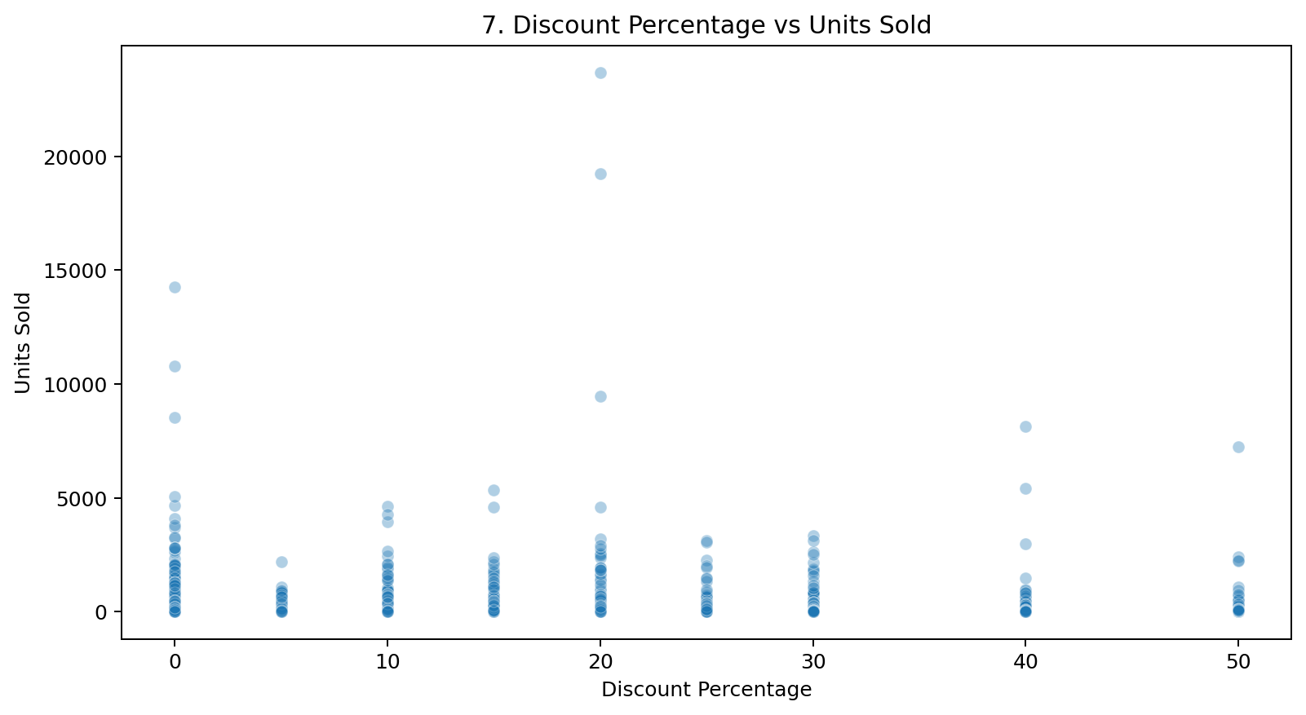
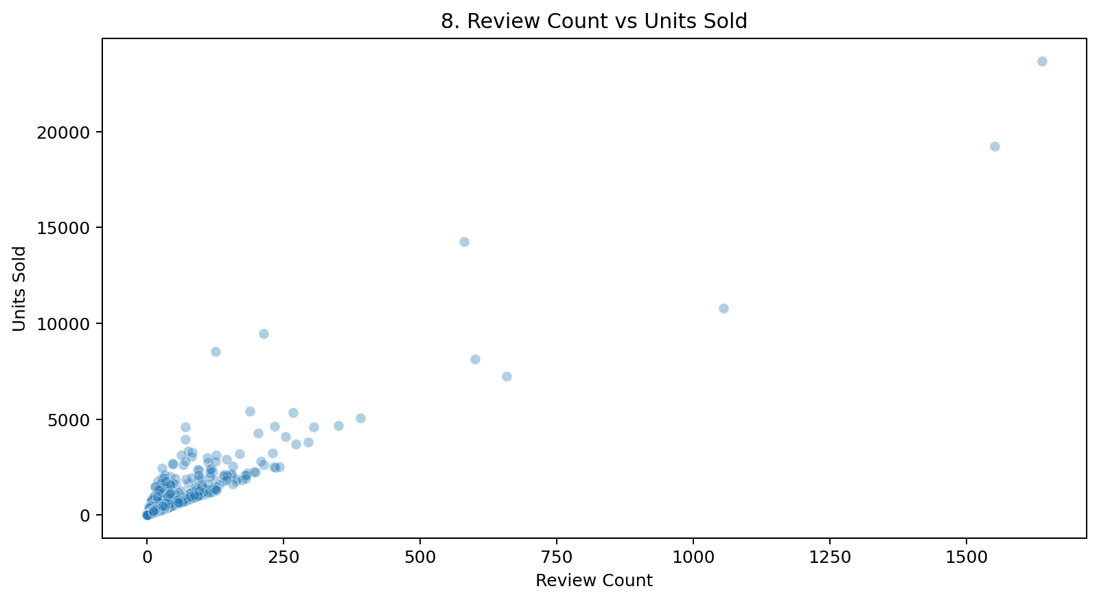
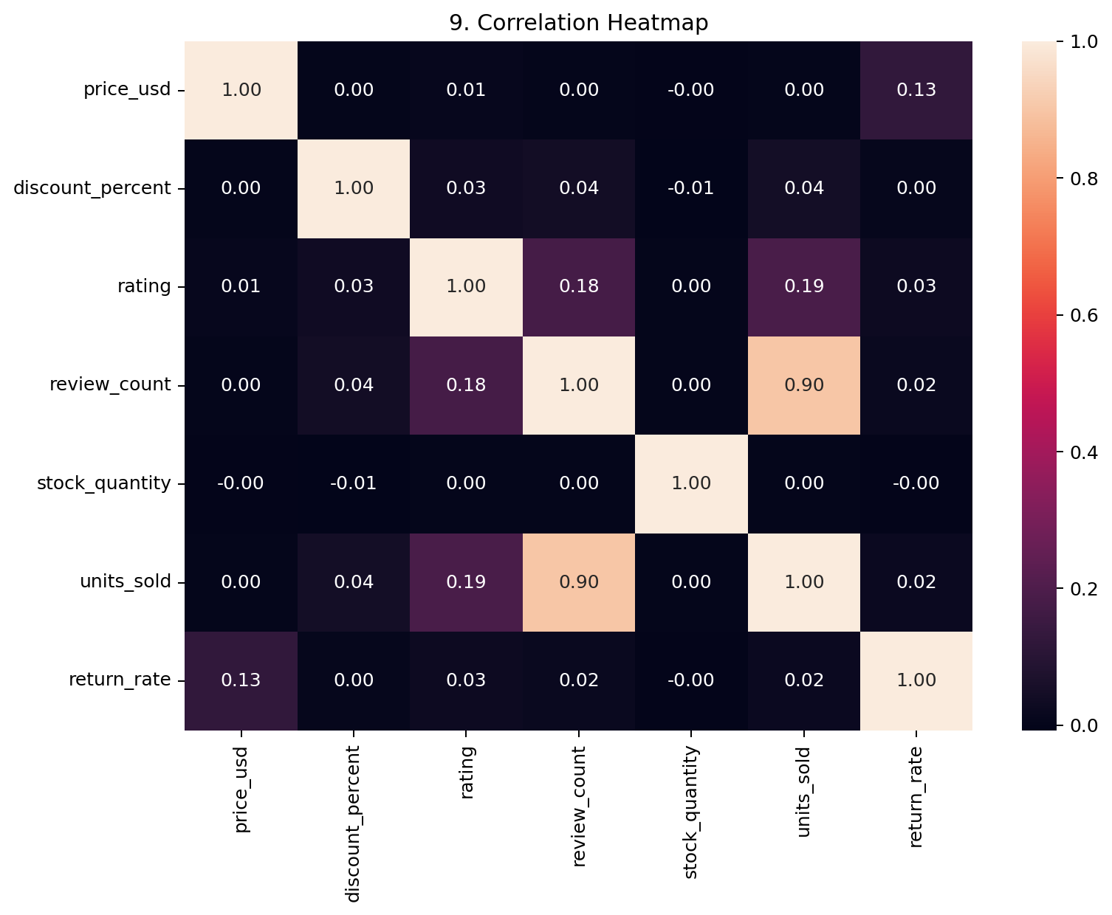
EDA Visualizations — Charts 7 to 9
Discount percentage has only a weak positive relationship with units sold; discount alone does not explain most sales variation.
Review count has a strong positive association with units sold; this is correlation, not proof of causation.
The heatmap shows review_count has the strongest simple correlation with units_sold among the numeric variables shown.

Slide 9
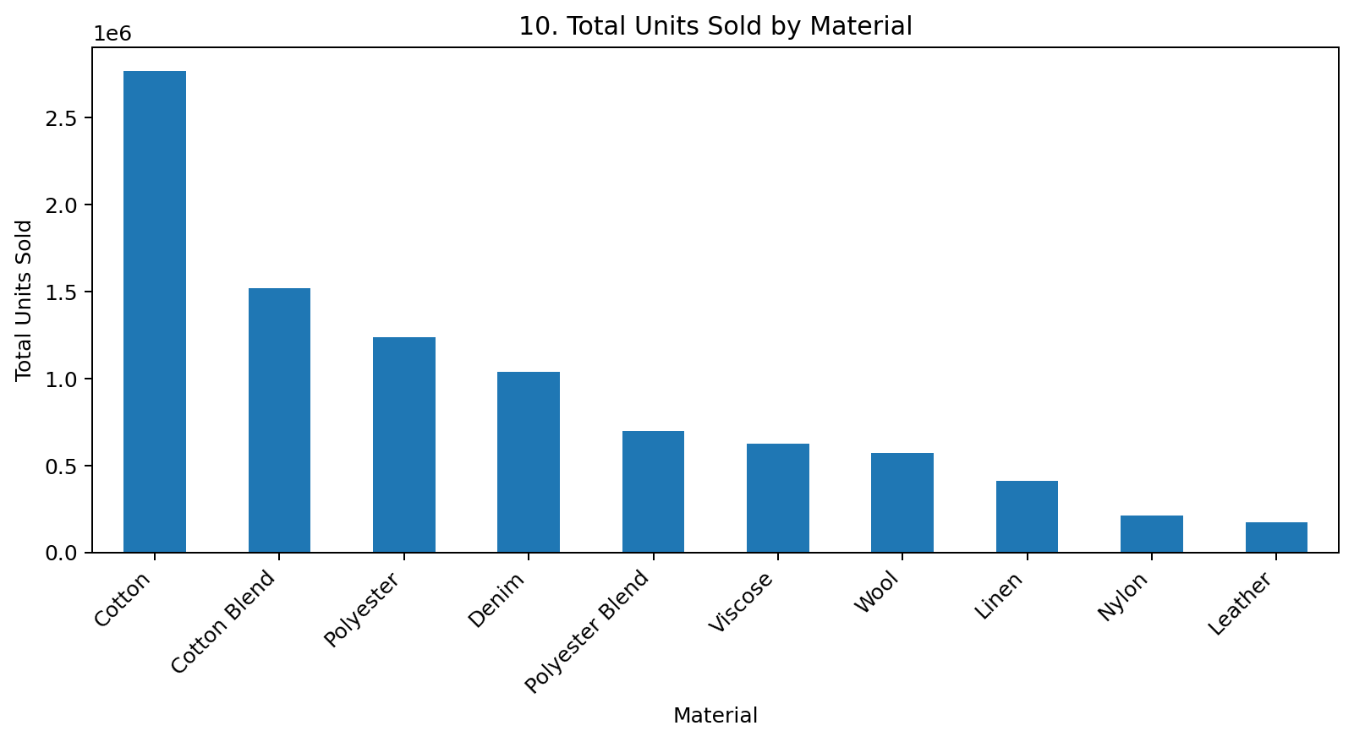
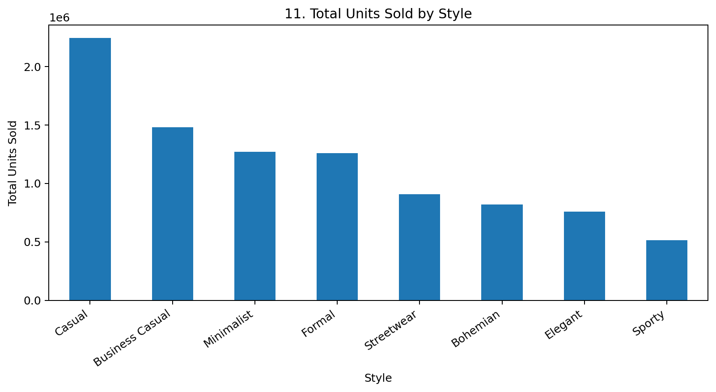
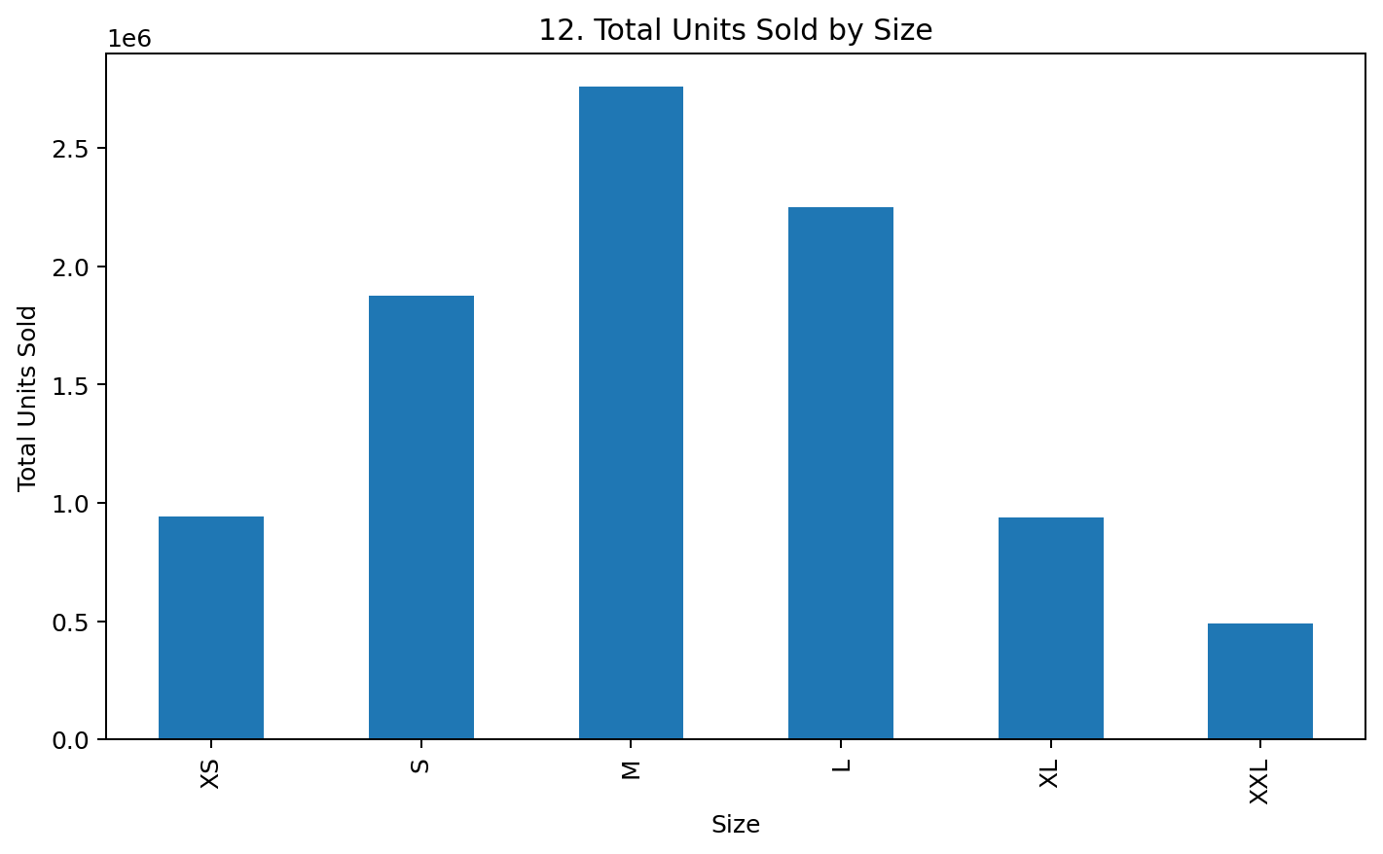
EDA Visualizations — Charts 10 to 12
Cotton is the highest-volume material by total units sold.
Casual is the highest-volume style by total units sold.
M is the highest-volume size, followed by L.

Slide 10
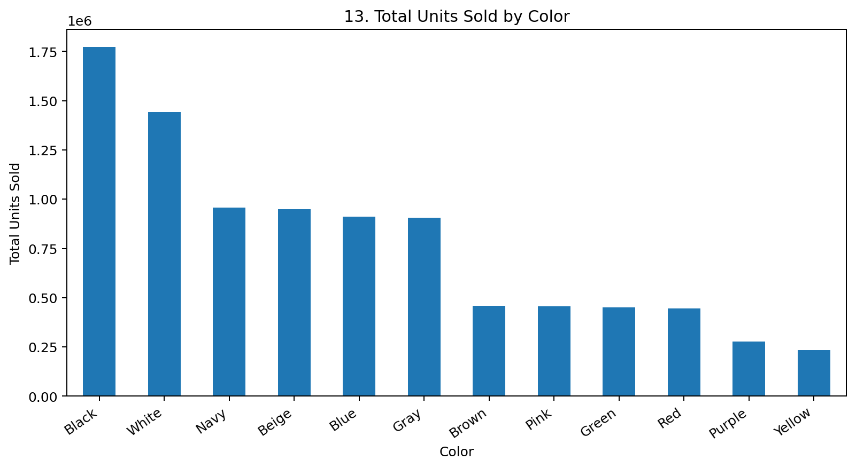
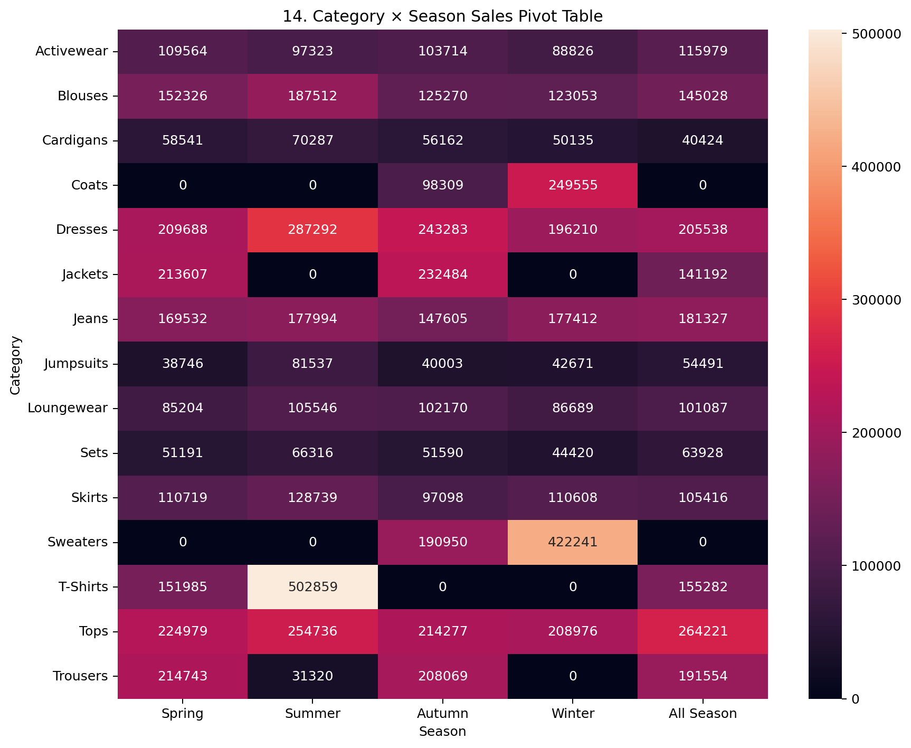
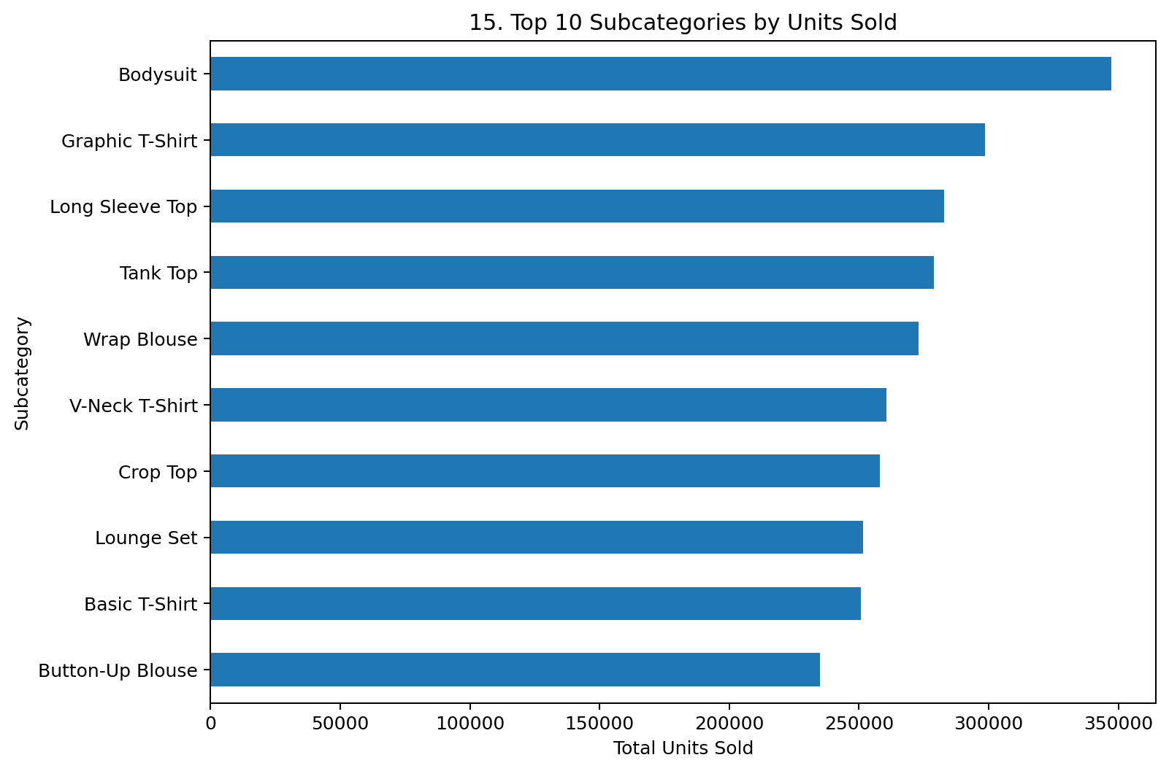
EDA Visualizations — Charts 13 to 15
Black is the highest-volume color by total units sold.
The category × season heatmap helps identify which category-season combinations contribute the most sales.
Bodysuit is the highest-selling subcategory in this dataset.

Slide 11
Key Insights
Tops recorded the highest total units sold , followed closely by Dresses .
Cotton was the highest-volume material with units sold.
Casual was the highest-volume style with units sold.
Size M had the highest total units sold followed by L .
Black was the highest-volume color with units sold.
Summer recorded the highest total units sold among the seasons .
The strongest simple numeric relationship is review_count vs units_sold (correlation ≈ 0.90); this indicates association, not proof that reviews cause sales.

Slide 12
Recommendations
Prioritize analysis and merchandising of high-volume categories such as Tops and Dresses.
Monitor high-volume materials such as Cotton when planning product assortment.
Use review and customer-feedback metrics as useful signals when evaluating product performance.
Track discount effectiveness by product category rather than assuming larger discounts always create higher sales.
Maintain adequate availability for high-volume sizes such as M and L.
Use category × season analysis to support seasonal assortment planning.
Monitor return rates alongside sales so that high sales are not evaluated in isolation.

Slide 13
Conclusion
The analysis shows clear differences in sales across categories, materials, styles, sizes, colors and seasons.
Tops, Dresses, Cotton, Casual style and size M are among the strongest volume segments in this dataset.
Review count has a strong association with units sold, while discount percentage shows only a weak association.
The analysis demonstrates the full EDA workflow: loading, cleaning, derived columns, groupby, pivot tables, correlations and 15 visualizations.
These findings can support assortment planning, inventory monitoring and further product-level analysis.

Slide 14
THANK YOU

